Slide 1
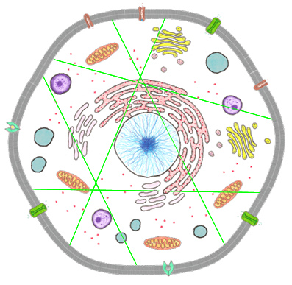
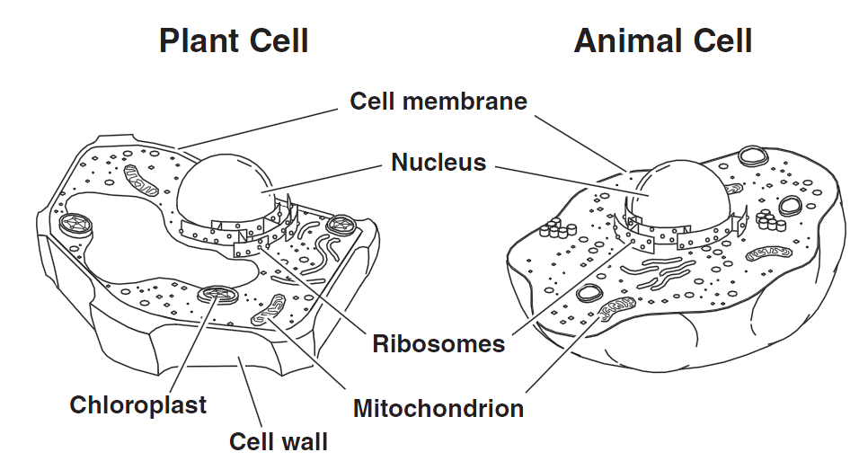
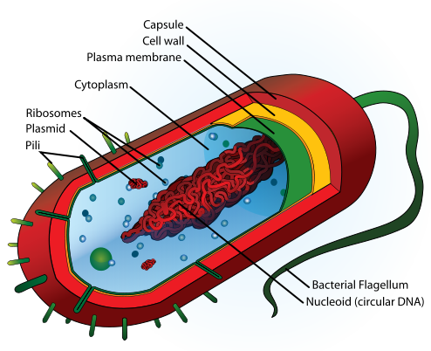
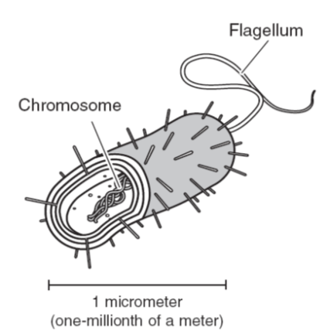
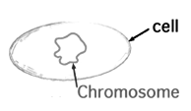
Comparing Eukaryotic and Prokaryotic Cells

Slide 2
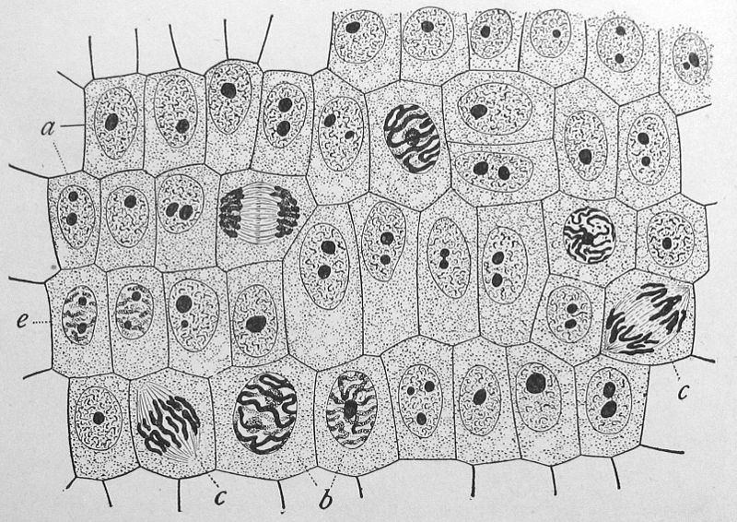
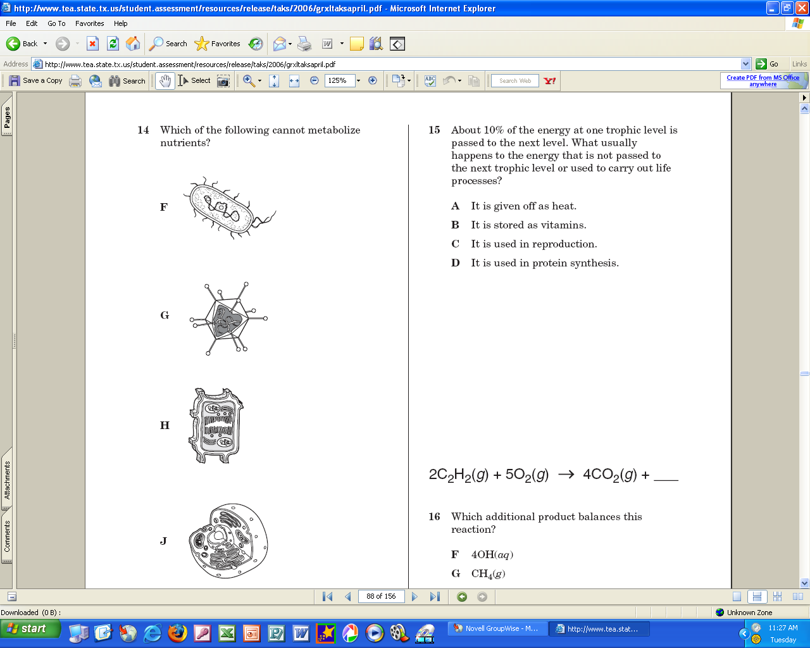

1. All living things are made of cells
A cell is the building block of all life. It is the smallest structure that can be classified as a complete living organism.

Slide 3
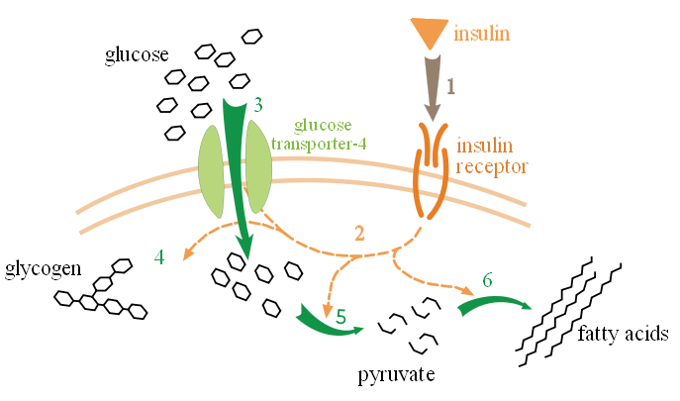
2. All cells metabolize nutrients
A metabolism is the set of chemical reactions that occur inside of cells.
Glucose metabolism

Slide 4
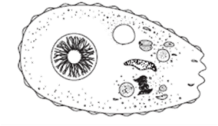
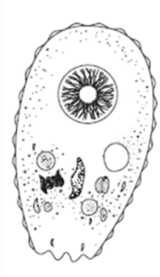
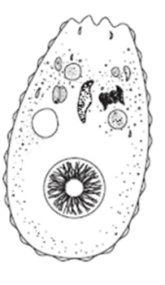
3. All cells reproduce themselves

Slide 5
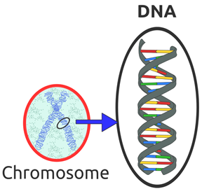
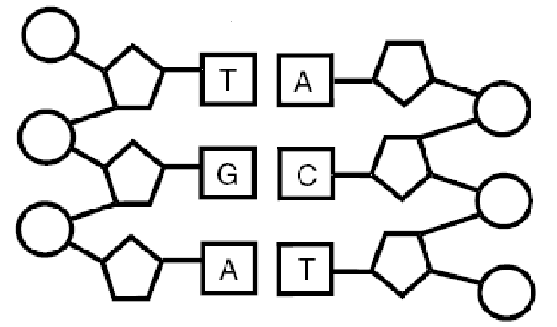
4. All cells contain genetic material
in the form of DNA.
DNA stands for deoxyribonucleic acid

Slide 6
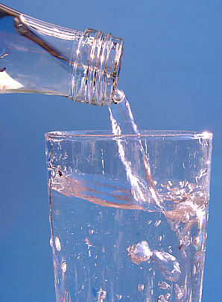
5. All living things maintain a steady balance of water, nutrients and energy known as homeostasis.
Photo by W.J.Pilsak

Slide 7
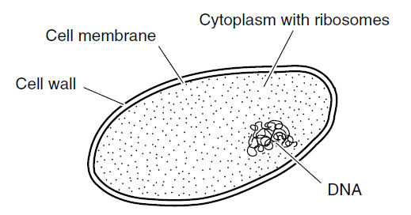
Cell Structures
All cells, and therefore all living things, have some organelles and structures in common.
Eukaryotes
Prokaryote

Slide 8
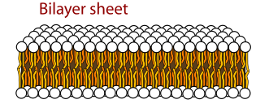
Cell Structures
All cells are surrounded by a cell membrane. Membranes are selectively permeable which means they only let certain things enter and exit the cell.

Slide 9
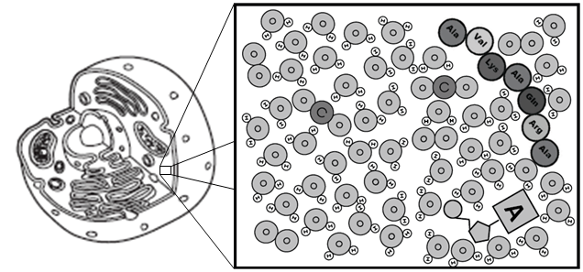

Cell Structures
All cells are full of an aqueous solution call the cytoplasm. It is an aqueous solution because the solvent is water! The cytoplasm contains all of the nutrients and organelles the cell needs.
= water

Slide 10
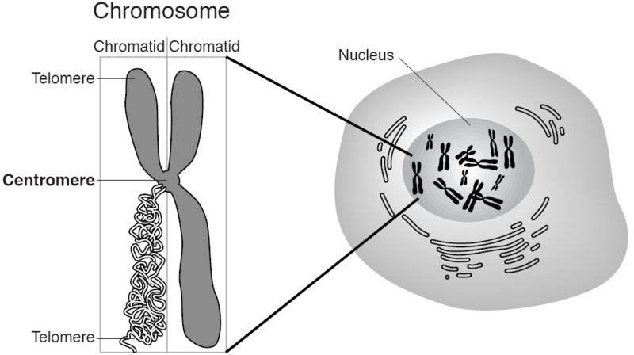
Cell Structures
Every cell contains genetic material in the form of DNA. This DNA is wrapped around proteins and packaged into large, complex structures called chromosomes.
Eukaryote
Prokaryote

Slide 11
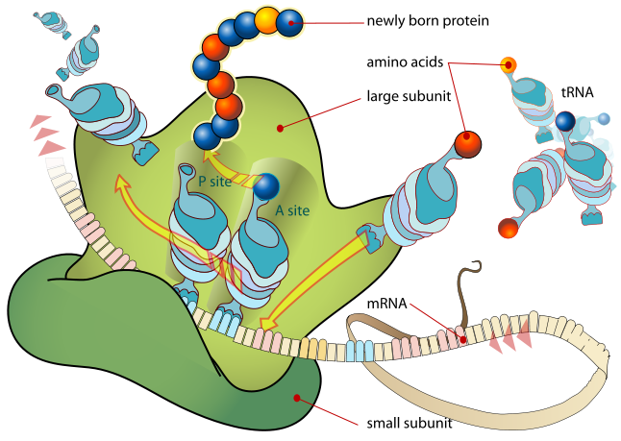
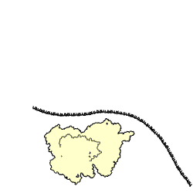
Cell Structures
The information that is stored in DNA is used to make all of the cell’s proteins. These instructions are sent out of the nucleus, and it is the ribosomes of the cell that read these instructions and make all of the cell’s proteins.

Slide 12
Eukaryotes and Prokaryotes
While EVERY cell has chromosomes containing DNA, the location of the chromosomes is the main difference between a eukaryotic and a prokaryotic cell.
Eukaryote
Prokaryote

Slide 13
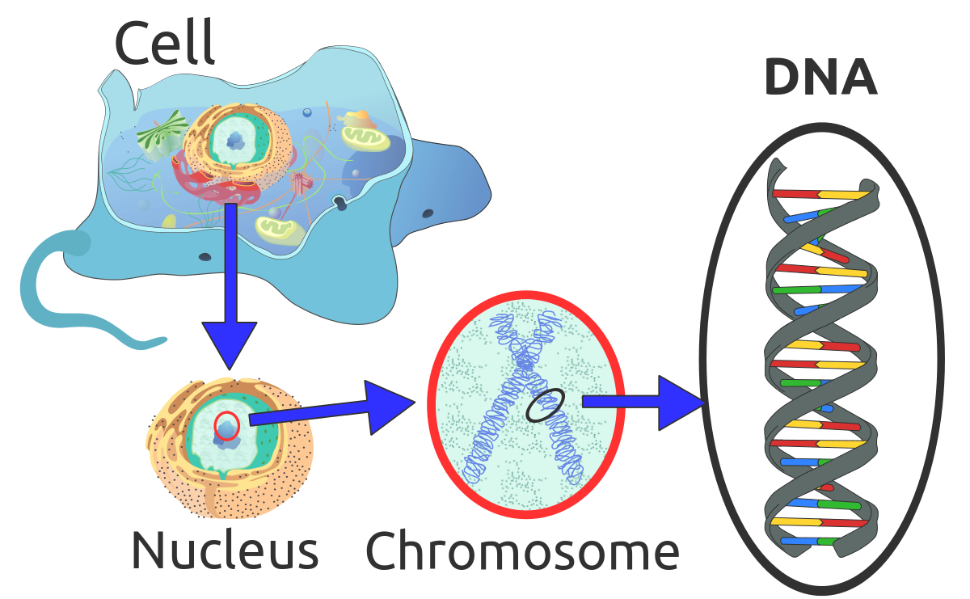
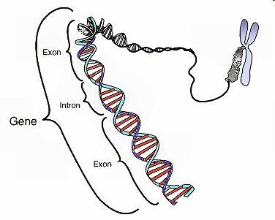
Eukaryotes and Prokaryotes
Eukaryotes store their DNA inside the nucleus. The nucleus controls the cell’s functions because it has the cell’s instructions in the form of DNA!

Slide 14
Eukaryotes and Prokaryotes
Prokaryotes have a circular chromosome of DNA that found in the cytoplasm of the cell. It is NOT stored inside its own organelle.
We call the chromosome “circular” because it makes a loop. It does not stay in the shape of a perfect circle.

Slide 15
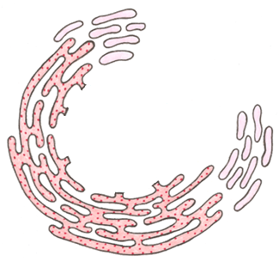


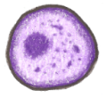
Eukaryotes and Prokaryotes
Eukaryotic cells also contain many other membrane-bound organelles like the ones shown below that have their own membranes.
Endoplasmic Reticulum
Mitochondrion
Lysosome
Golgi body
Prokaryotic cells do NOT contain any membrane-bound organelles.

Slide 16
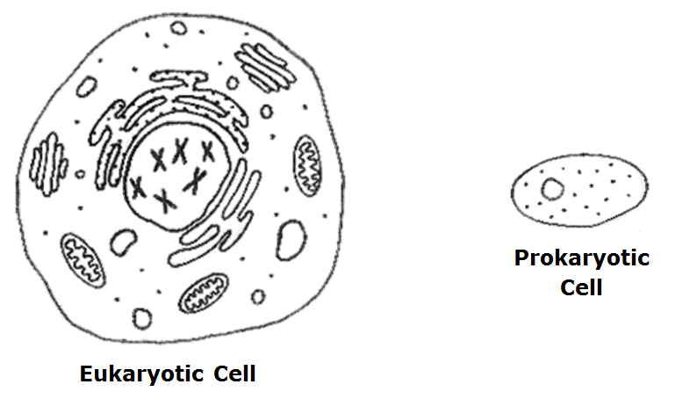
Labeling Your Cells
Outer boundary – controls what enters and exits the cells.

Slide 17
Labeling Your Cells
The solution of water, nutrients and organelles. (The stuff on the inside!)

Slide 18

Labeling Your Cells
Large structures of DNA. In eukaryotes they are linear (straight) and in prokaryotes they are circular.

Slide 19
Labeling Your Cells
The small organelles that synthesize new proteins for the cell.

Slide 20
Labeling Your Cells
NO Nucleus
All of the chromosomes (DNA) are inside this organelle in eukaryotes.

Slide 21

Labeling Your Cells
NO Membrane-bound organelles
Any organelle with its own membrane
(e.g. Golgi bodies, mitochondria, endoplasmic reticulum)

