Slide 1

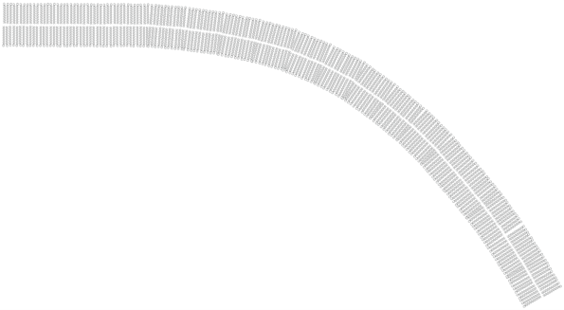







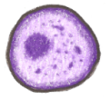


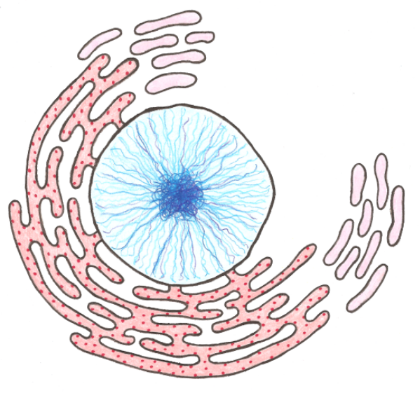

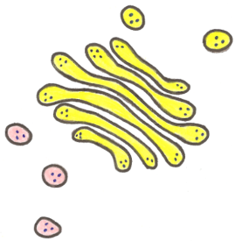

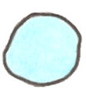


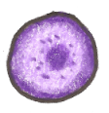


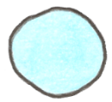
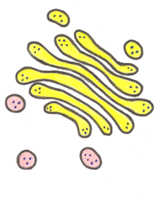



The Eukaryotic Cell
Mitochondrion
Cell Membrane
Cytoskeleton
Endoplasmic
Reticulum
Ribosome
Nucleus
Vacuole
Vesicle
Golgi Body
Lysosome
© Patrick Haney
Switch to Prokaryotic Cell

Slide 2
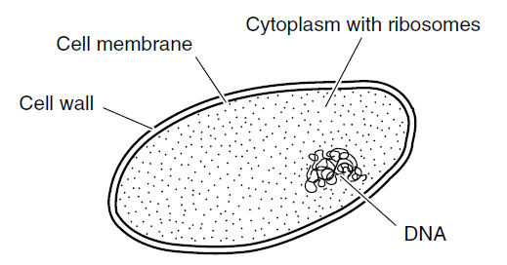
The Prokaryotic Cell
Cytoskeleton
Prokaryotes do not have a nucleus or any other membrane-bound organelles!

Slide 3
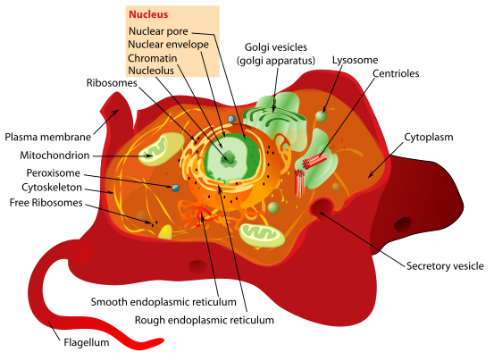
The Eukaryotic Cell
Eukaryotic cells are complex cells that contain many specialized parts known as organelles. These organelles often have their own membrane, and they help the cell perform the complex tasks needed for survival.

Slide 4
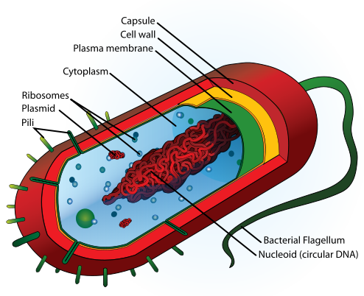
The Prokaryotic Cell
Prokaryotic cells are cells that do NOT contain any membrane-bound organelles. They do still contain some organelles, such as ribosomes and cell walls. Because they do not contain individual compartments, they are much smaller than eukaryotes.
Return to Prokaryotic Cell

Slide 5
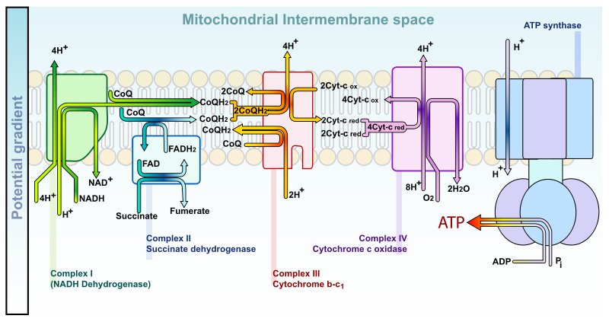
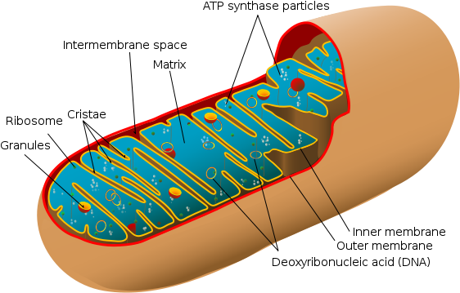
Mitochondrion
The cell’s mitochondria perform the energy conversions necessary to transfer the bulk of the energy taken from food molecules into the energy molecule called ATP. This is why the mitochondria are known as the powerhouse of the cell.

Slide 6
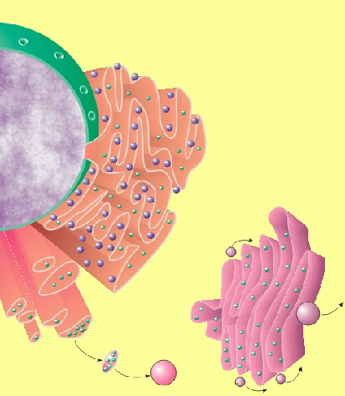
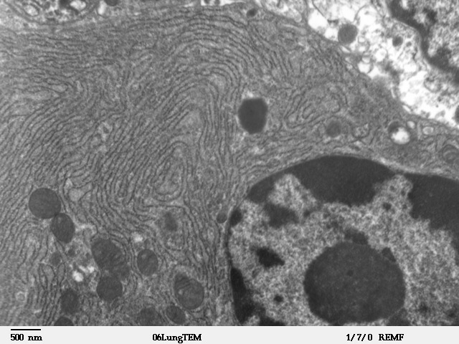
Endoplasmic Reticulum
Endoplasmic Reticulum
Nucleus
The endoplasmic reticulum (ER) is the location where many important molecules are created and metabolized. The rough ER is where proteins are translated. It is the ribosomes that give the rough ER its bumpy appearance. The smooth ER is where lipids and steroids are synthesized. The endoplasmic reticulum also distributes these new molecules throughout the cell.
Golgi Apparatus
vesicle

Slide 7
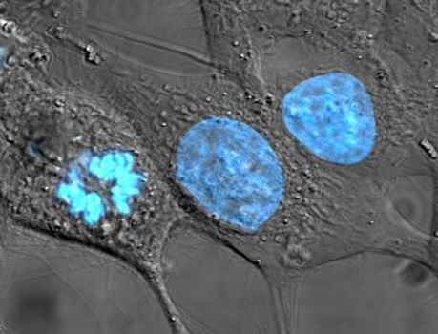
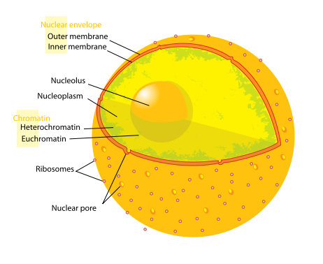
Nucleus
The nucleus contains the genetic material of the cell in the form of DNA. This DNA is packaged into large structures known as chromosomes. The DNA contains the instructions or blueprint for the cell, which is why the nucleus is often referred to as the control center of the eukaryotic cell.

Slide 8
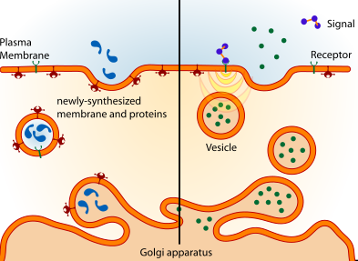
Vesicle
Vesicles are small membrane bound sacs that are used to transport molecules into, out of and through the eukaryotic cell.
Endoplasmic Reticulum
Nucleus
Golgi Apparatus
vesicle

Slide 9
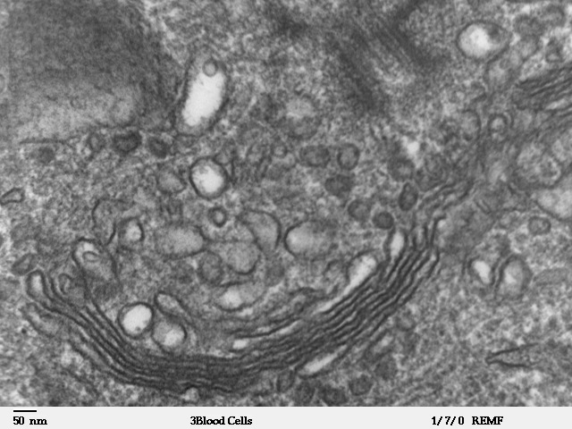
Golgi Body
also known as the Golgi Apparatus
Endoplasmic Reticulum
Nucleus
The primary function of the Golgi apparatus is to modify and package large molecules, primarily proteins and lipids. This is especially important for proteins that will eventually leave the cell. Sugars and lipid molecules are added to the proteins in the Golgi so that they can perform specific functions.
Golgi Apparatus
vesicle

Slide 10
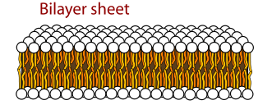
Cell Membrane
The cell membrane provides a barrier for the cell. The main job of the cell membrane is to maintain the steady balance of nutrients and energy in the cell we call homeostasis. It does this by regulating which molecules enter and leave the cell. The cell membrane also helps the cell communicate with other cells.

Slide 11
Return to Prokaryotic Cell
Cell Membrane
The cell membrane provides a barrier for the cell. The main job of the cell membrane is to maintain the steady balance of nutrients and energy in the cell we call homeostasis. It does this by regulating which molecules enter and leave the cell. The cell membrane also helps the cell communicate with other cells.

Slide 12
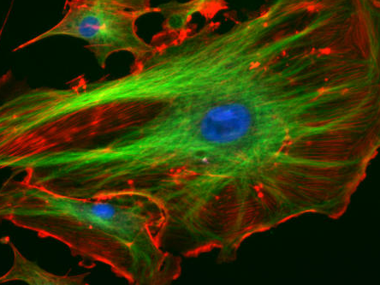
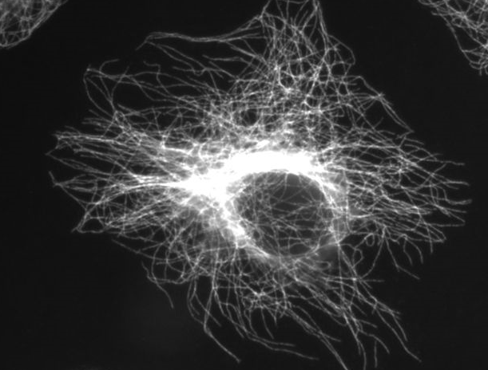
Cytoskeleton
Cyto- means cell, and the cytoskeleton is made up of the long, strong proteins that helps the cell keep its shape and structure. It also helps the cell divide into two cells as it reproduces.

Slide 13
Return to Prokaryotic Cell
Cytoskeleton
Cyto- means cell, and the cytoskeleton is made up of the long, strong proteins that helps the cell keep its shape and structure. It also helps the cell divide into two cells as it reproduces.

Slide 14
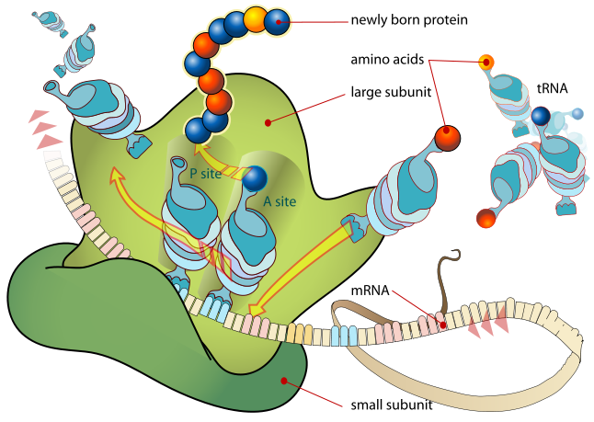
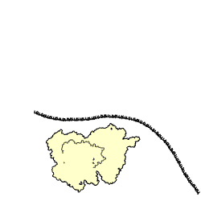
Ribosome
Ribosomes are made mostly of rRNA, and they are found in the cytoplasm of the cell. They are the molecular machines that organize the translation of proteins. Ribosomes are found in high numbers in the rough endoplasmic reticulum where much of the cell’s translation of proteins occurs.

Slide 15
Return to Prokaryotic Cell
Ribosome
Ribosomes are made mostly of rRNA, and they are found in the cytoplasm of the cell. They are the molecular machines that organize the translation of proteins. Ribosomes are found in high numbers in the rough endoplasmic reticulum where much of the cell’s translation of proteins occurs.

Slide 16
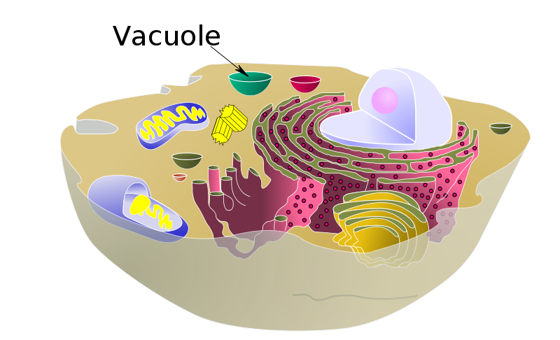
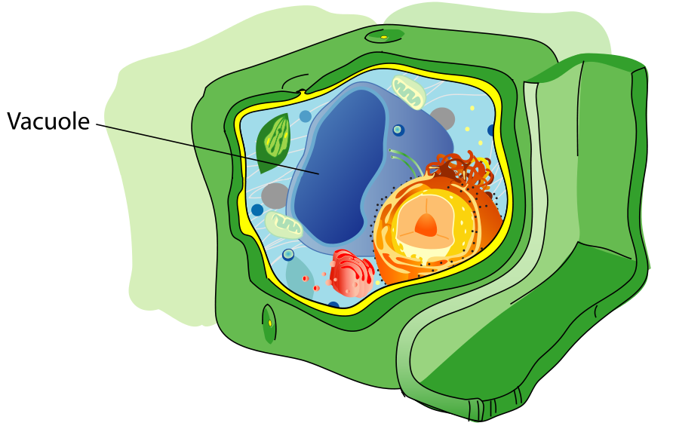
Vacuole
Vacuoles are membrane bound organelles which contain water and other molecules. Vacuoles can serve many purposes including storing nutrients and isolating wastes. The central vacuole in plant cells helps the plant maintain turgor pressure which keeps the cell rigid and stiff.

Slide 17
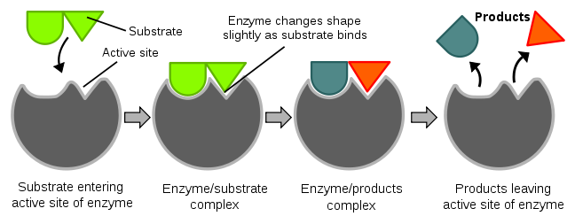
Lysosome
Lysosomes are spherical organelles which contain digestive enzymes. These enzymes digest large molecules and break them apart into their pieces. Lysosomes are responsible for digesting food molecules, recycling worn out organelles and breaking apart harmful bacteria and viruses that are engulfed by the cell.

Slide 18
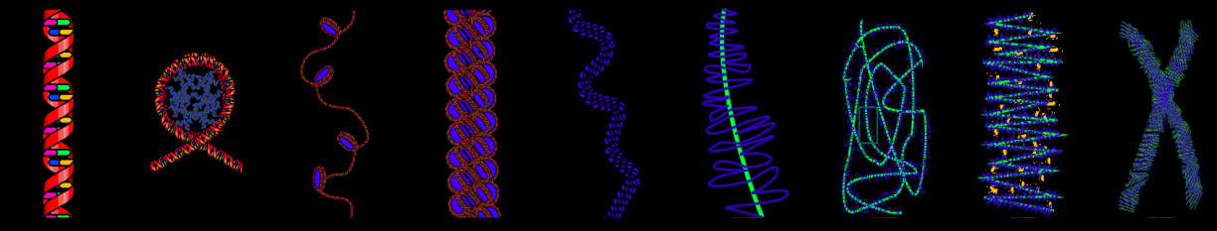
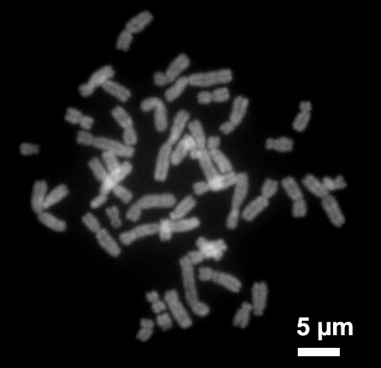
Click here to return to Nucleus slide.
Chromosomes
Human Chromosomes
DNA is wound and wound into very compact structures called chromosomes. Each chromosome contains a large amount of DNA. DNA is the molecule that contains the blueprint for the cell.

Slide 19
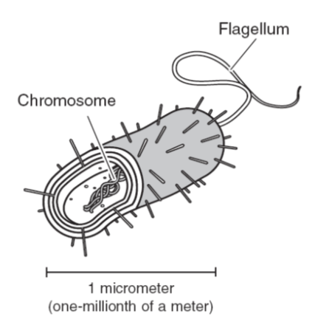
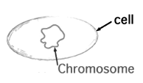
Return to Prokaryotic Cell
Chromosome
Prokaryote
DNA is wound and wound into very compact structures called chromosomes. DNA is the molecule that contains the blueprint for the cell. In prokaryotes, there is only one, circular chromosome. One main difference between prokaryotes and eukaryotes is that prokaryotes do NOT have a nucleus to store DNA inside of.

Slide 20

Return to Prokaryotic Cell
Cell Wall
Some prokaryotic cells have a cell wall. This cell wall is usually made of peptidoglycan and it provides the cell with additional protection and structural support.
Bacterial Cell
Prokaryote

